Slide 1
An Introduction to Deep Learning with fast.ai
By: Ahad Jawaid

Slide 2
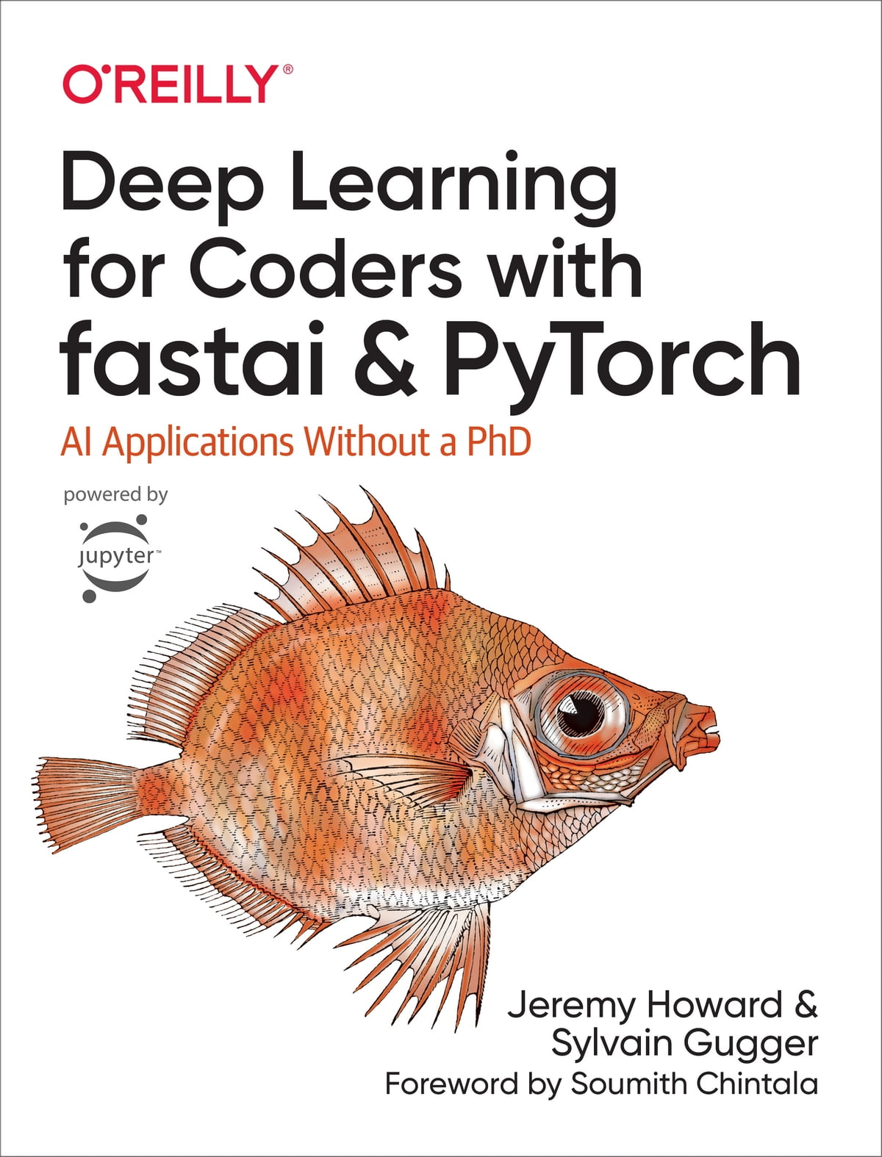

Sources
Figure and content are from “Deep Learning for Coders with fastai & PyTorch” by Jeremy Howard and Sylvain Gugger
https://course.fast.ai/

Slide 3
Goals
Understand what deep learning is
Understand a neural network
Understand transfer learning
Fine tune a deep learning model
Deploy a deep learning model

Slide 4
Agenda
What is Machine Learning
How to train machine learning model
Transfer Learning
What is Fast.ai
Workshop time!!

Slide 5
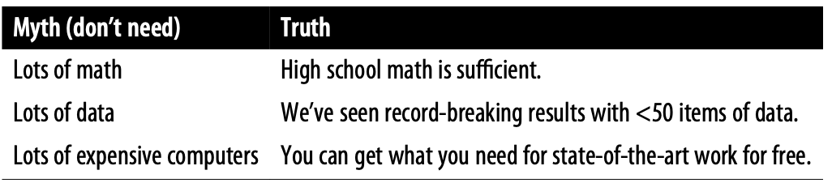
Machine Learning is for everyone

Slide 6
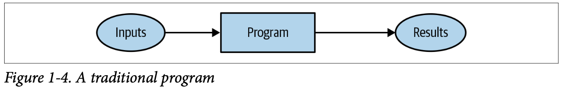
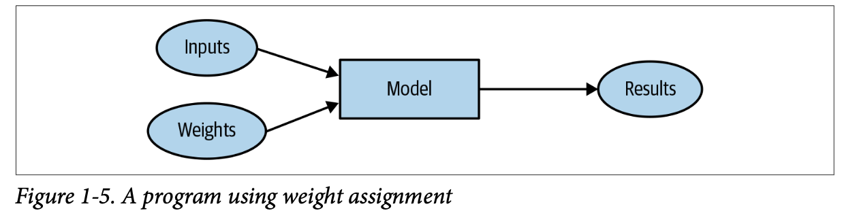
Program vs Machine Learning

Slide 7
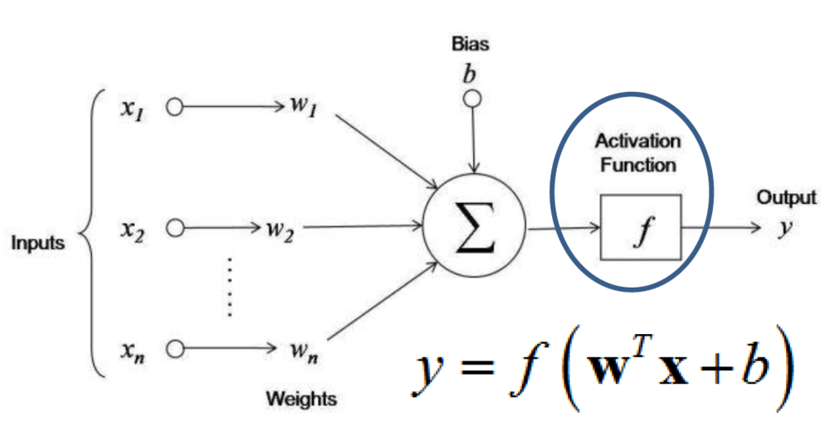
What are weights?

Slide 8
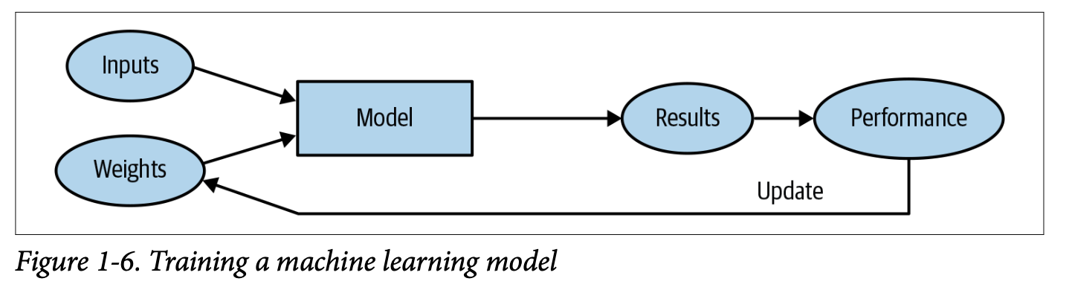
Training a Machine Learning Model

Slide 9
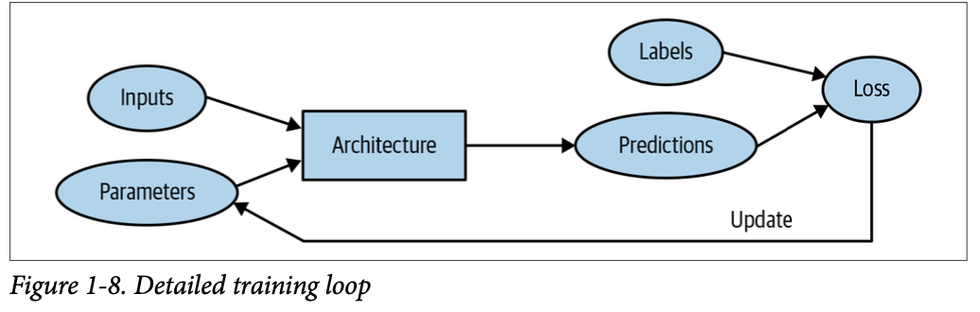
Training a Machine Learning Model

Slide 10
Jargon
Architecture = functional form of the model
Parameters = weights
Prediction = output of model
Label = Correct output
Performance = Loss of the model

Slide 11
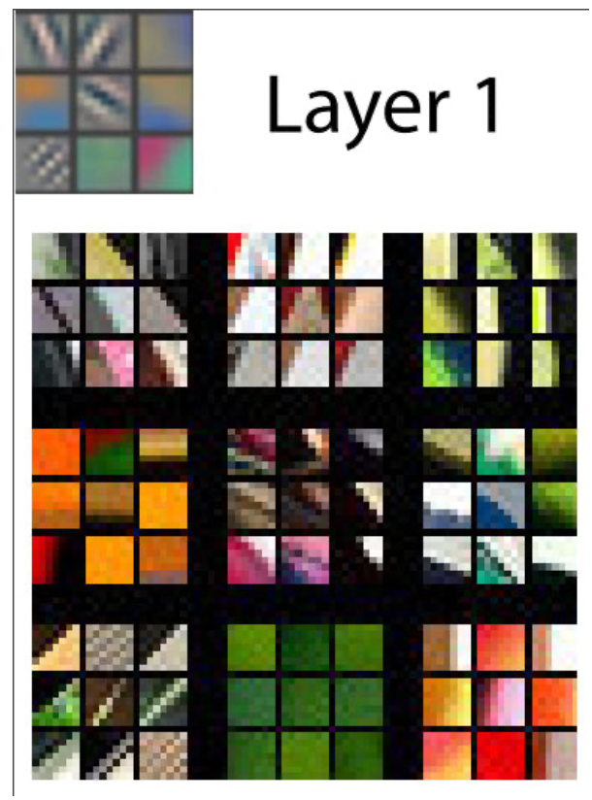
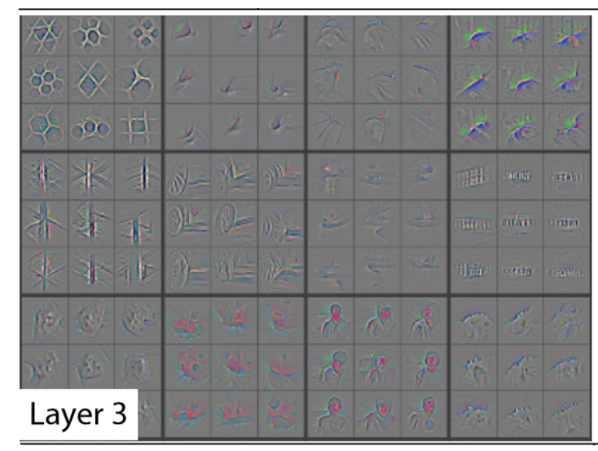
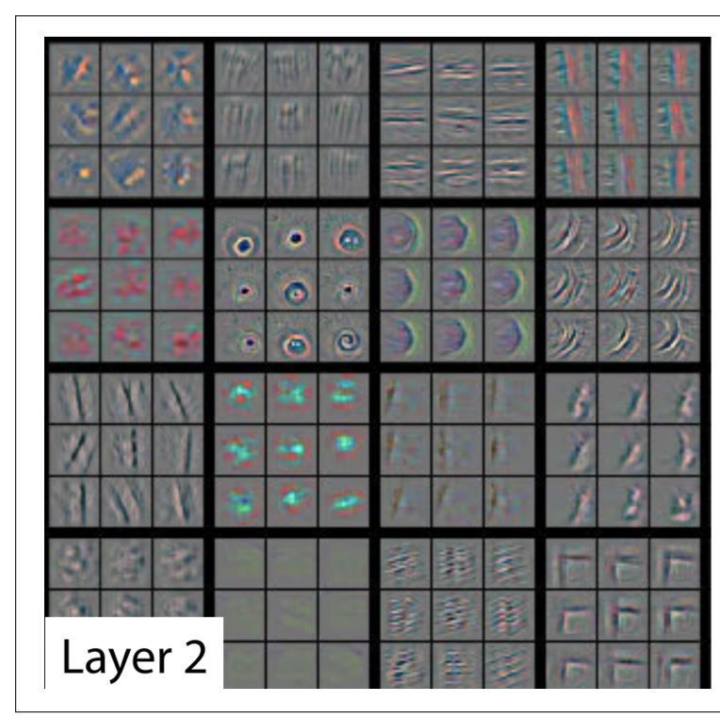
Visualizing Neural Network

Slide 12
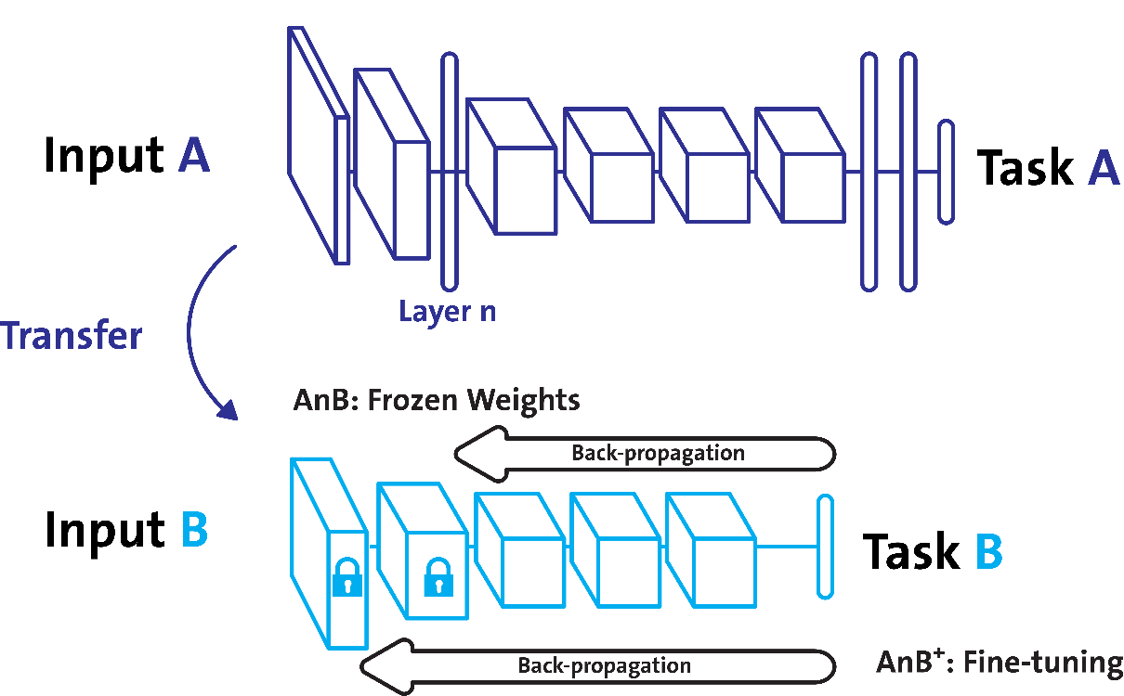
Transfer Learning

Slide 13


What is fast.ai

Slide 14
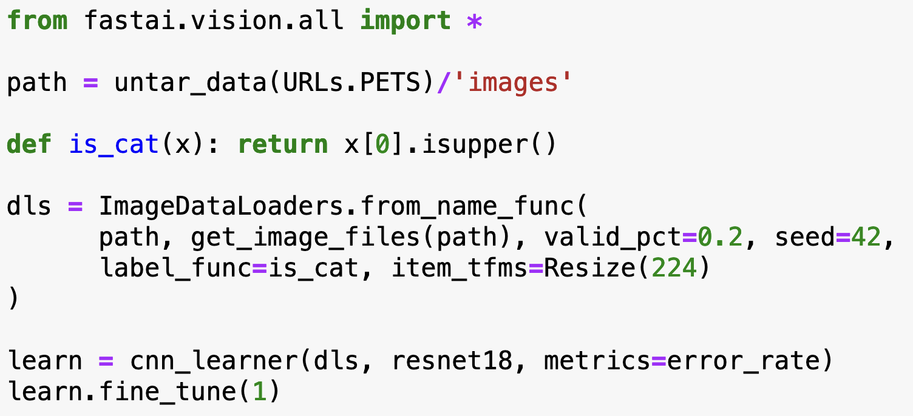
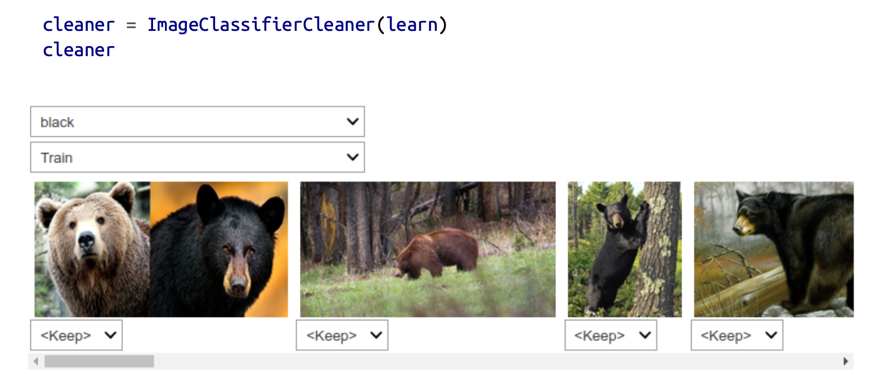
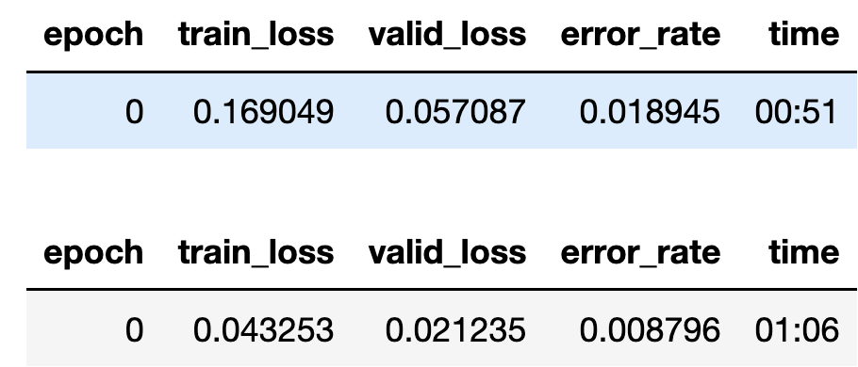
Why use fast.ai

Slide 15

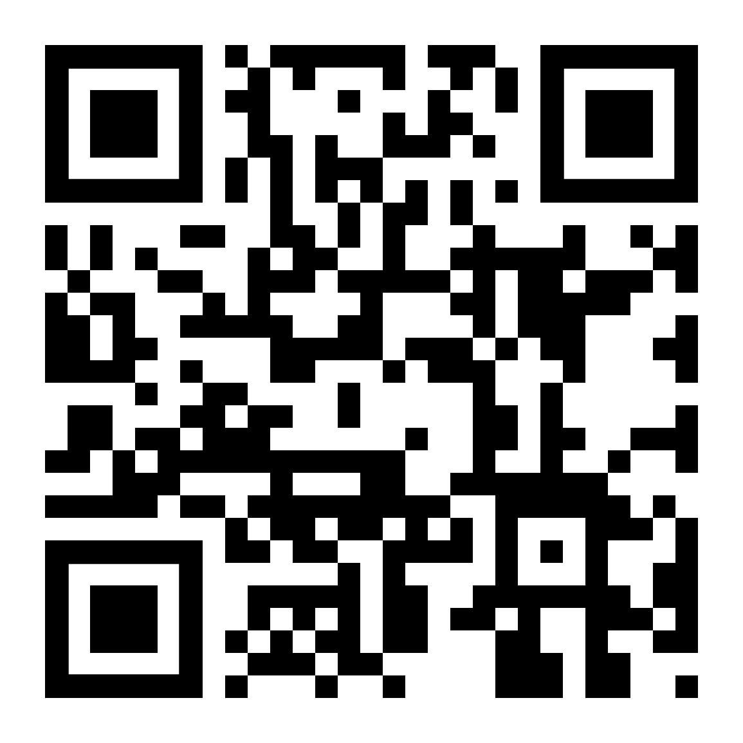
Workshop time!!
https://github.com/ahadjawaid/fastai-workshop
Feedback Form:

